Slide 1
KMITL Residence
Group#8

Slide 2

Agenda
Features
UI
Services
APIs
Endpoint name
Request format
Response format
Database

Slide 3

1. Features
Room Finding
Relax a sensational room in the best hotel of ladkrabang district.
Hotel Booking
Easily book hotel rooms at the best real-time rates.
News
A source and distribution point for the latest news in KMITL Residence.

Slide 4

1. Features
Online Payment
Secure online payment processing services through credit card and internet banking.
Guest Review
More feedback with review express of KMITL Residence.
Summary
Analyze summary transactional data by our staffs.

Slide 5
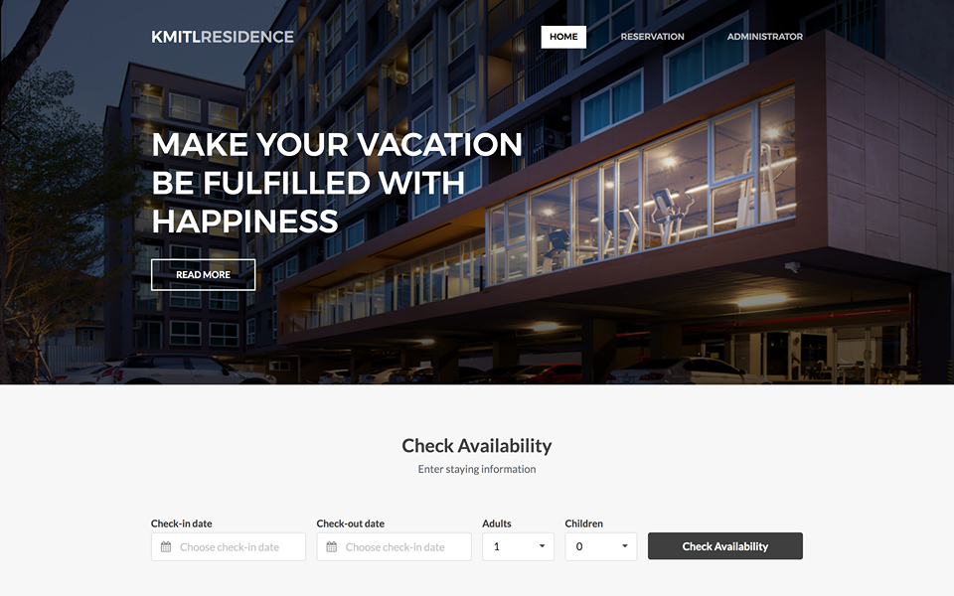
2. UI: Reservation (Home)

Slide 6
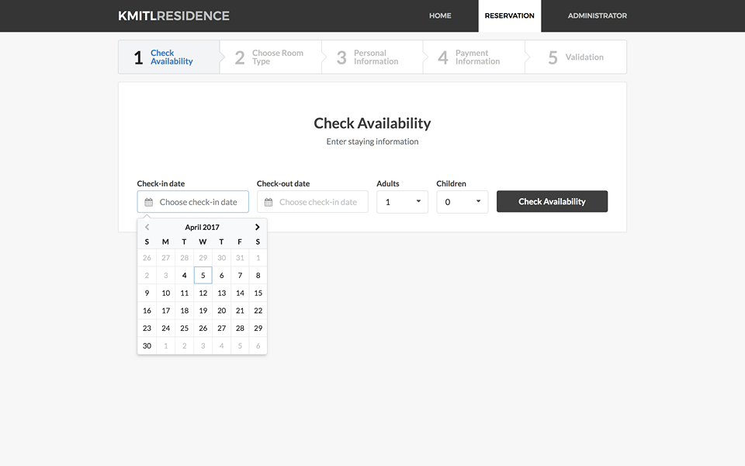
2. UI: Reservation (check availability)

Slide 7
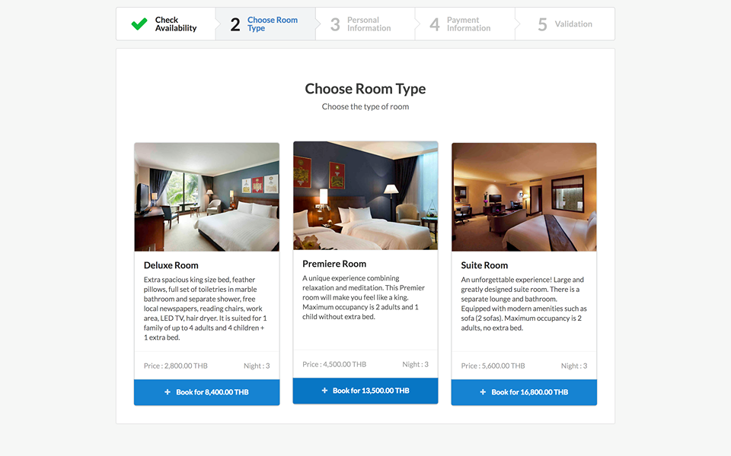
2. UI: Reservation (choose room type)

Slide 8
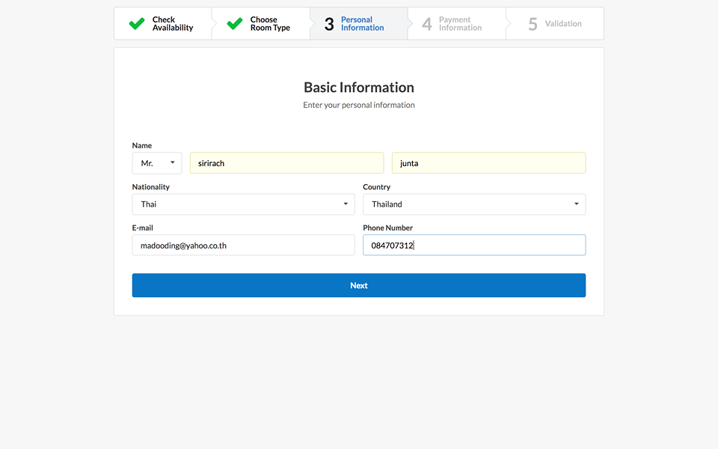
2. UI: Reservation (personal information)

Slide 9
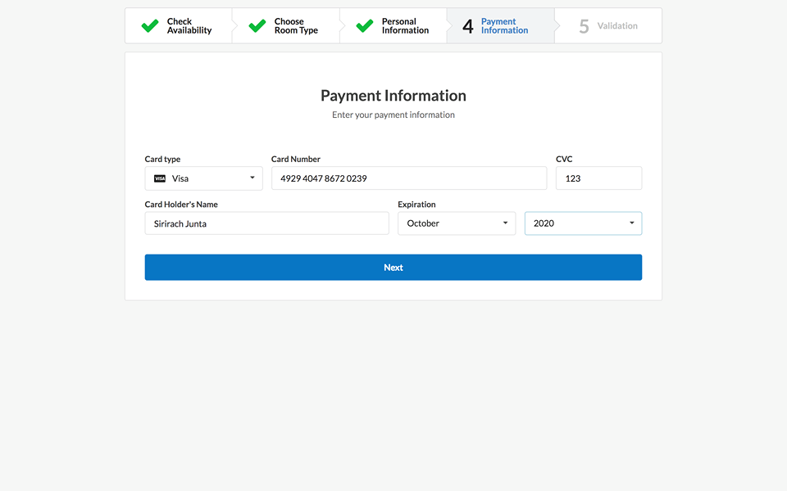
2. UI: Reservation (payment information)

Slide 10
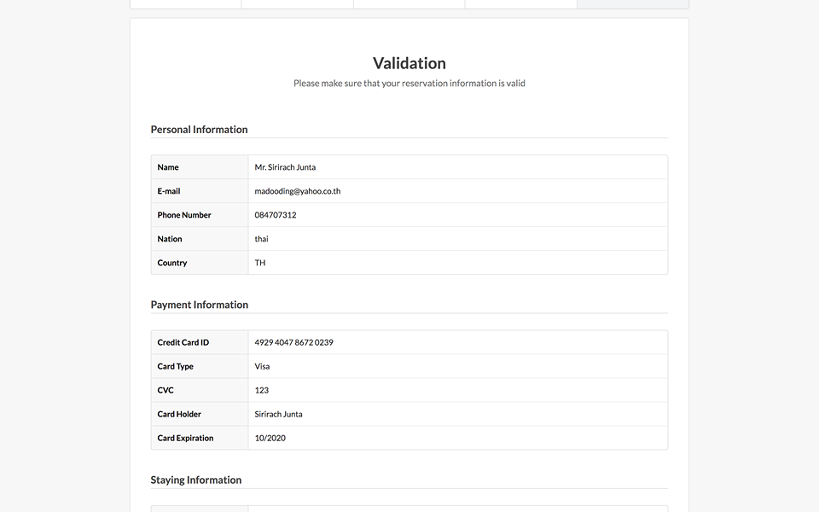
2. UI: Reservation (validation)

Slide 11
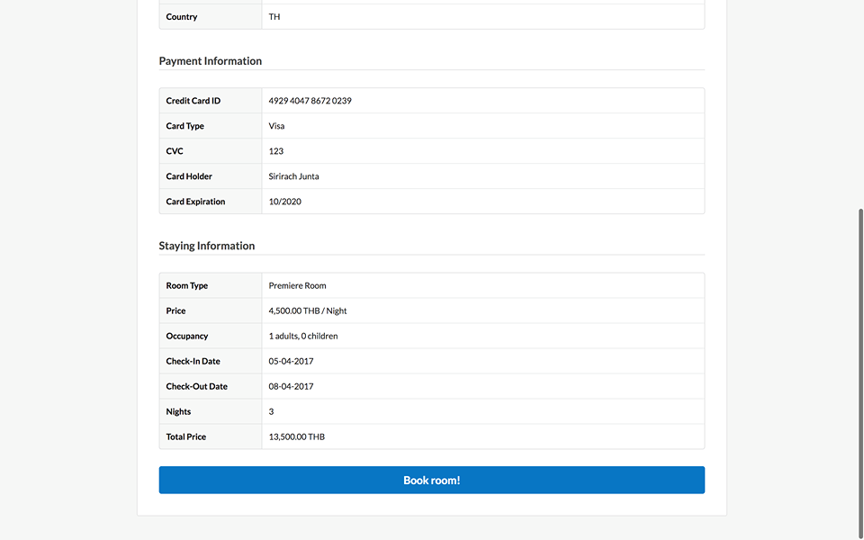
2. UI: Reservation (validation)

Slide 12
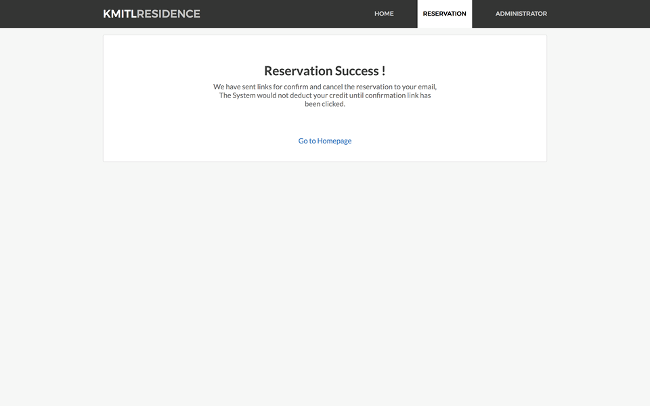
2. UI: Reservation (reservation success)

Slide 13
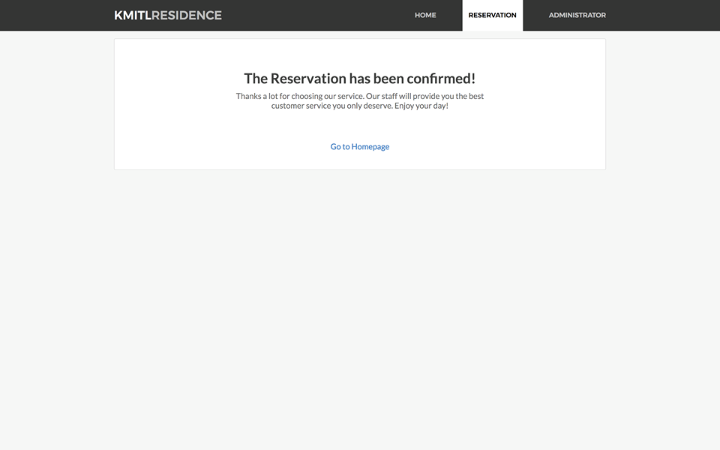
2. UI: Reservation (reservation confirmed)

Slide 14

2. UI: Reservation (reservation cancelled)

Slide 15

3. Services
Room Service
Reservation Service
Email Service
User Service

Slide 16
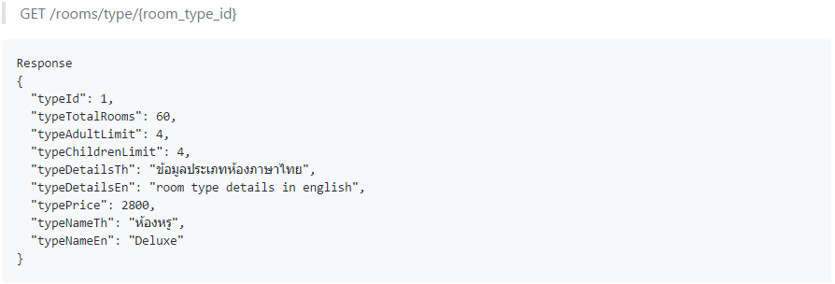
3. Services (Room Service)

Slide 17
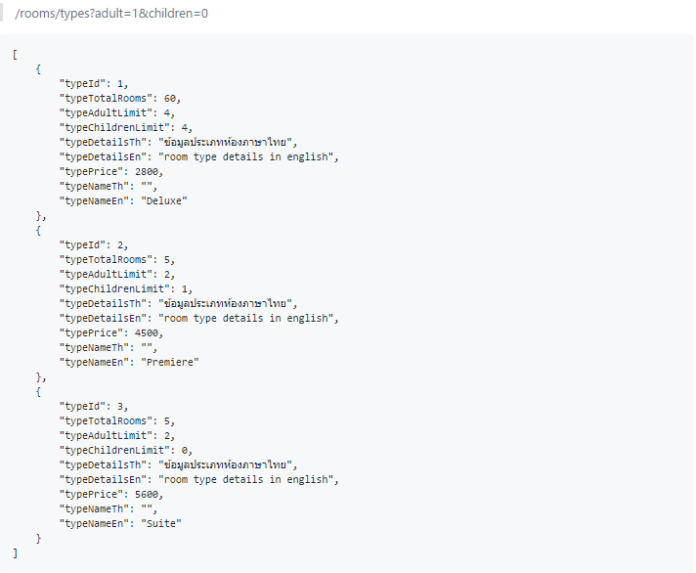
3. Services (Room Service)

Slide 18
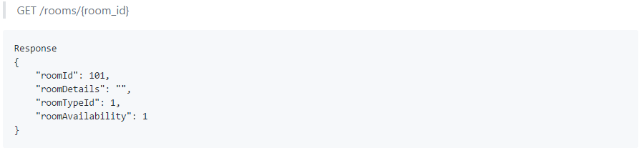
3. Services (Room Service)

Slide 19
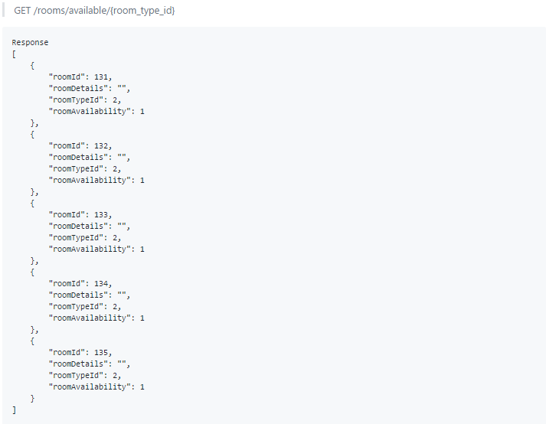
3. Services (Room Service)

Slide 20
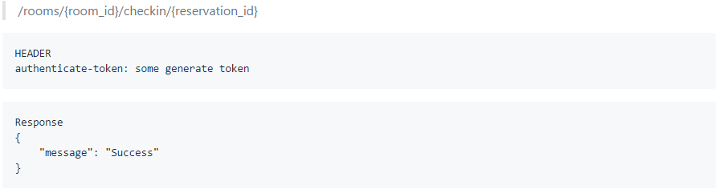
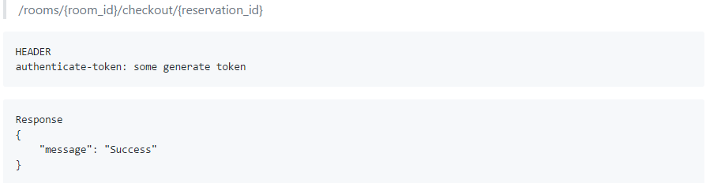
3. Services (Room Service)

Slide 21
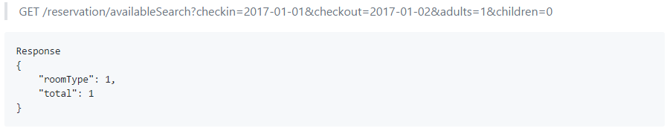
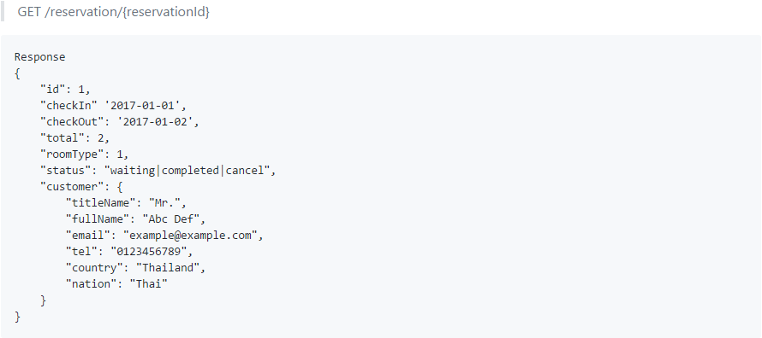
3. Services (Reservation Service)

Slide 22
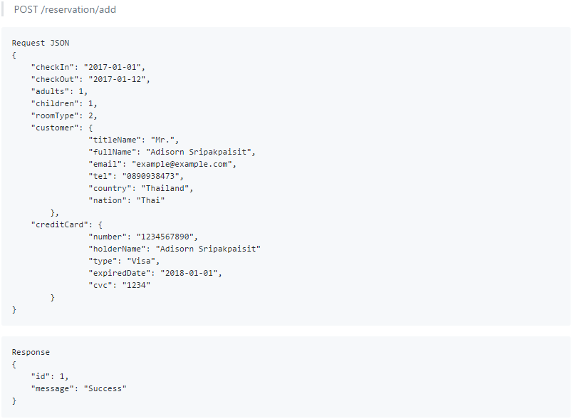
3. Services (Reservation Service)

Slide 23
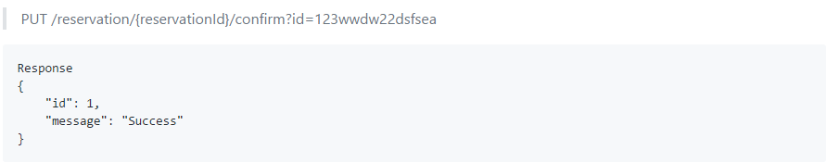
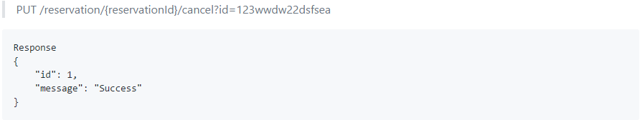
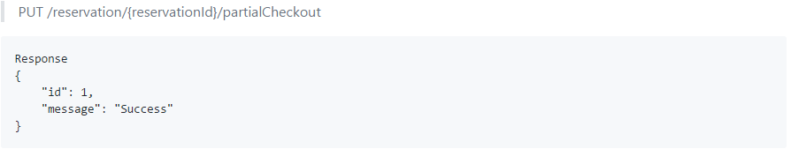
3. Services (Reservation Service)

Slide 24
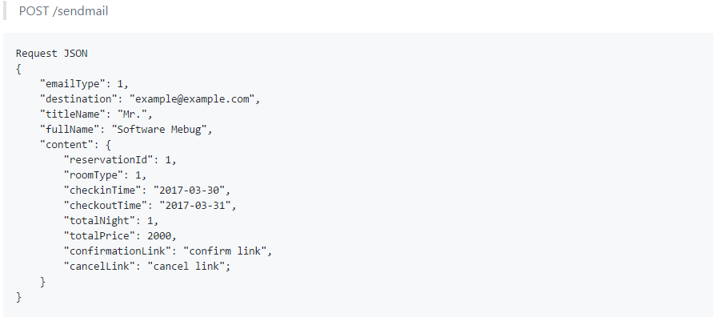
3. Services (Email Service)

Slide 25
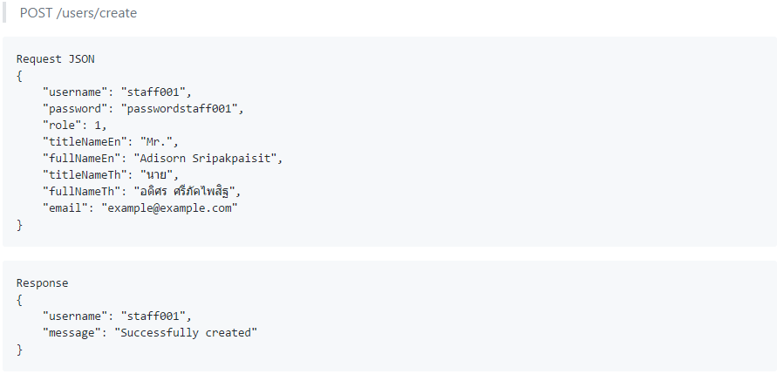
3. Services (User Service)

Slide 26
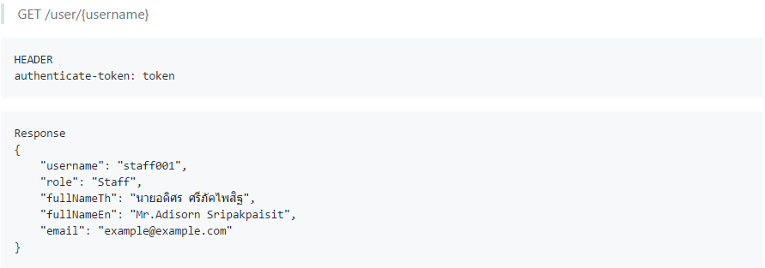
3. Services (User Service)

Slide 27
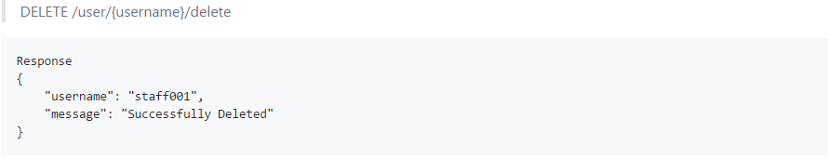
3. Services (User Service)

Slide 28
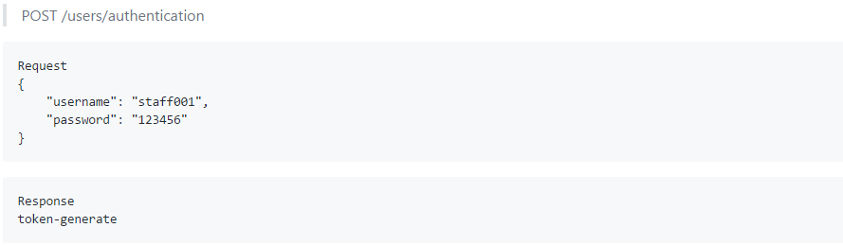
3. Services (User Service)

Slide 29
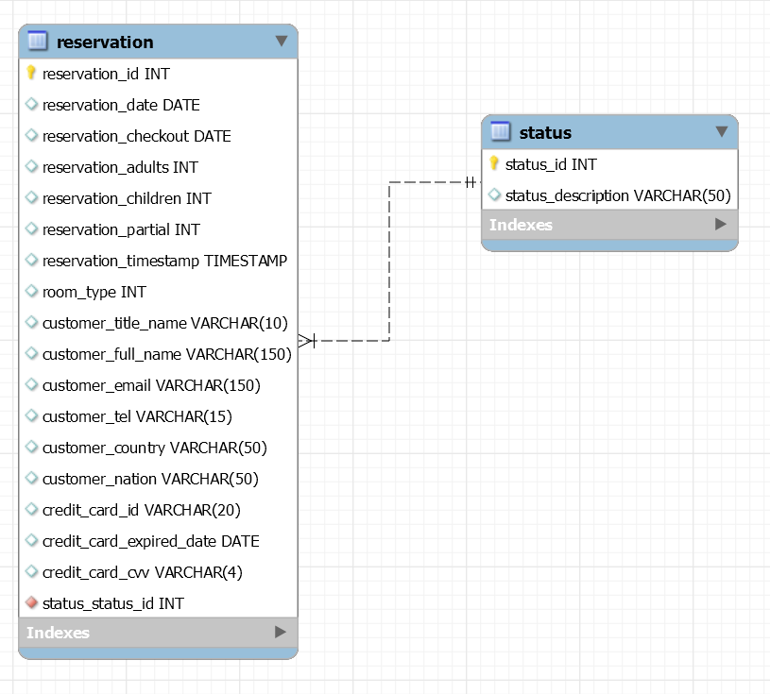
4. Database
Reservation Service

Slide 30
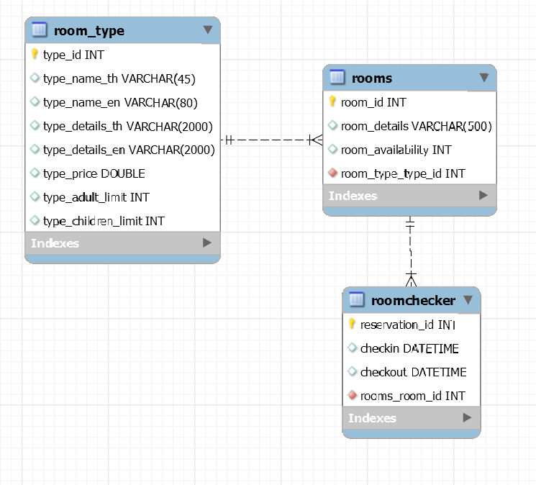
4. Database
Room Service

Slide 31
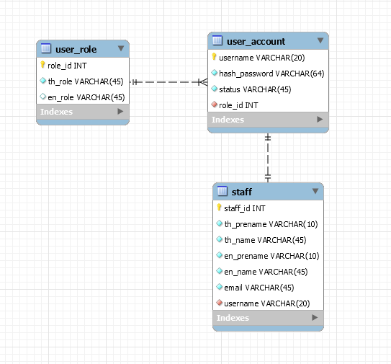
4. Database
User Service

Slide 32
Q&A

